Slide 1

Temporal Dynamics and Recurrent Neural Networks
Jan Williams
Department of Mechanical Engineering, University of Washington, Seattle WA
^{Email: jmpw1@uw.edu}
Temporal Dynamics and Recurrent Neural Networks

Slide 2
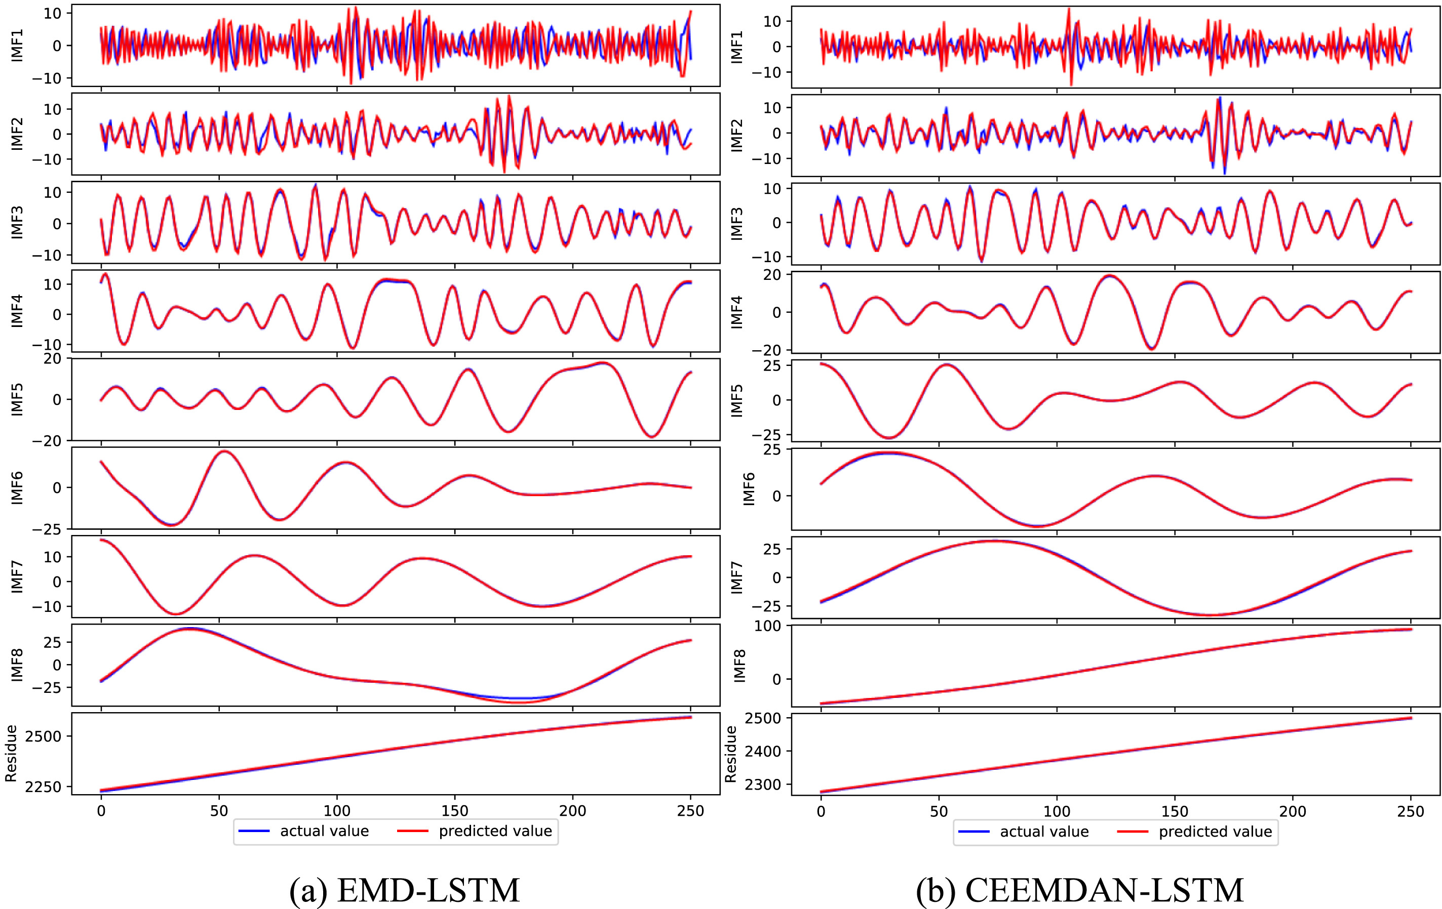
Why recurrence?
Sequential data
Variable length inputs
Variable length outputs
Sequential data processes
Image/signal processing
Increased information content
Jian Cao, Zhi Li, and Jian Li, “Financial time series forecasting model based on CEEMDAN and LSTM,” Physica A: Statistical Mechanics and its Applications, Volume 519, 2019
Temporal Dynamics and Recurrent Neural Networks

Slide 3
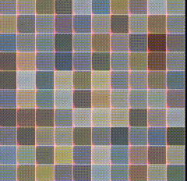
Why recurrence?
Sequential data
Variable length inputs
Variable length outputs
Sequential data processes
Image/signal processing
Increased information content
Karol Gregor et al., “DRAW: A recurrent neural network for image generation,” arXiv preprint arXiv:1502.04623, 2015
Temporal Dynamics and Recurrent Neural Networks

Slide 4
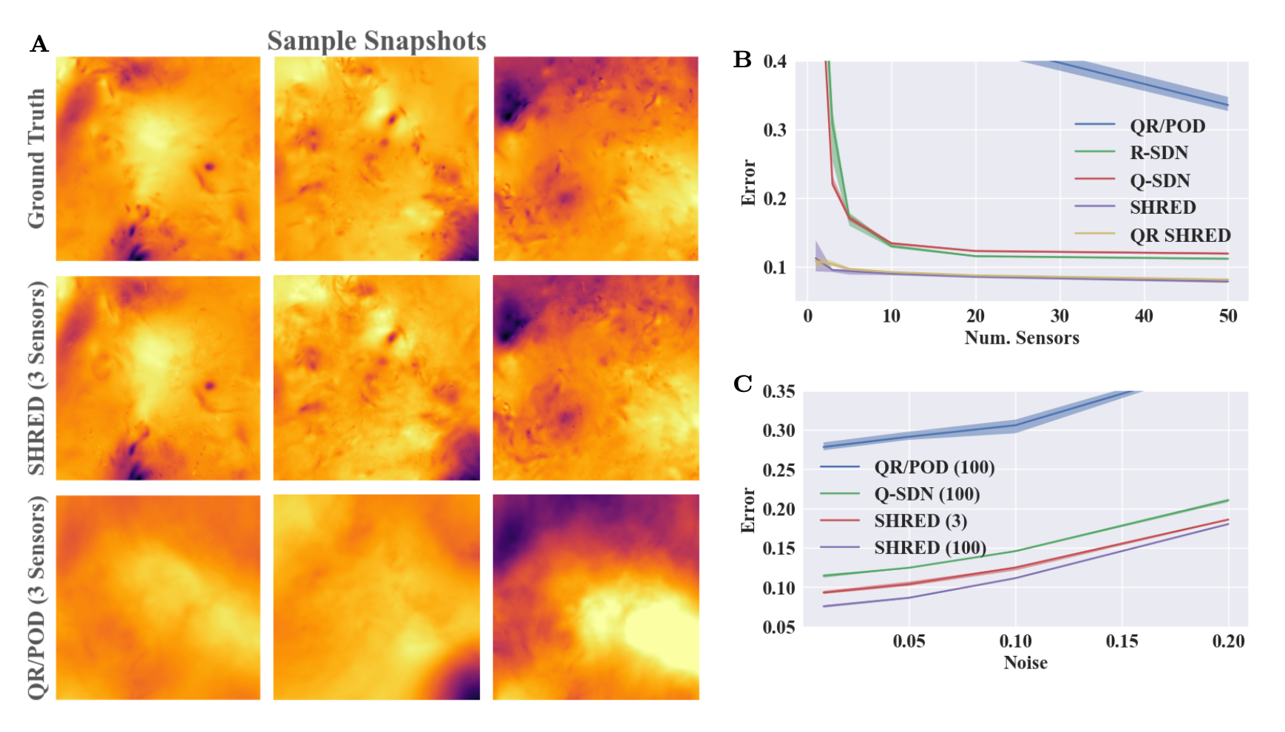
Why recurrence?
Sequential data
Variable length inputs
Variable length outputs
Sequential data processes
Image/signal processing
Increased information content
Jan P. Williams, Olivia Zahn, and J. Nathan Kutz, “Sensing with shallow recurrent decoder networks,” arXiv preprint arXiv:2301.12011, 2023
Temporal Dynamics and Recurrent Neural Networks

Slide 5
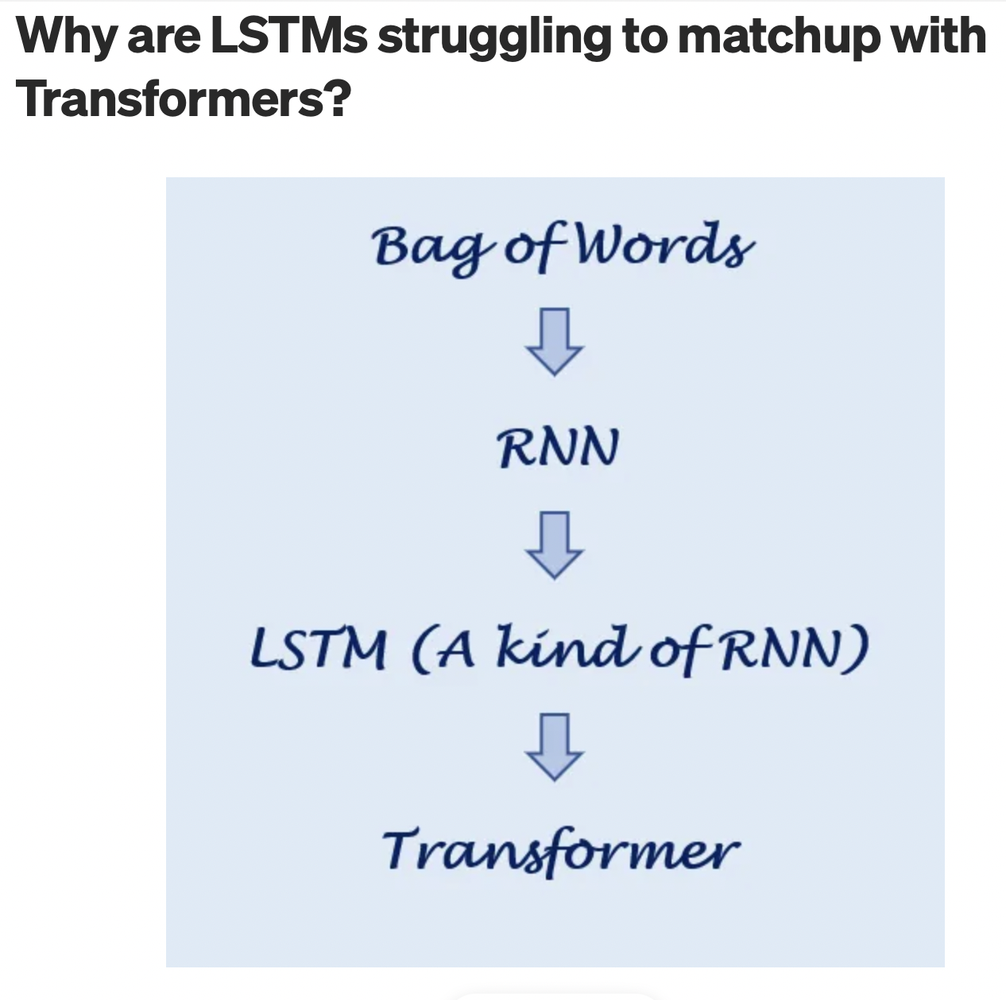
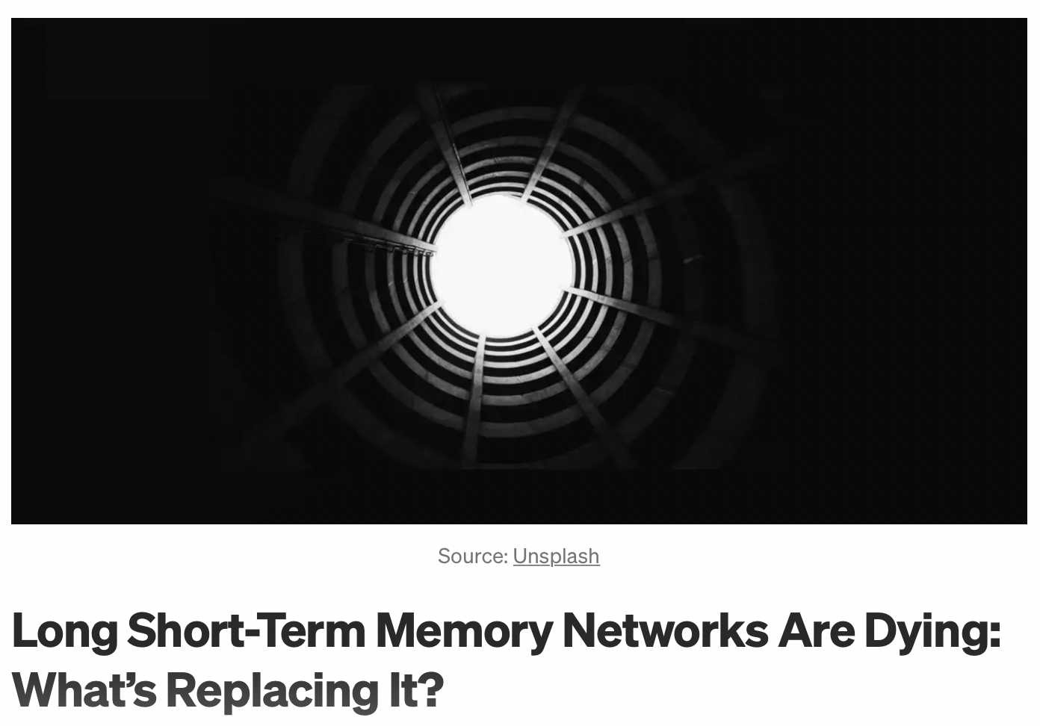
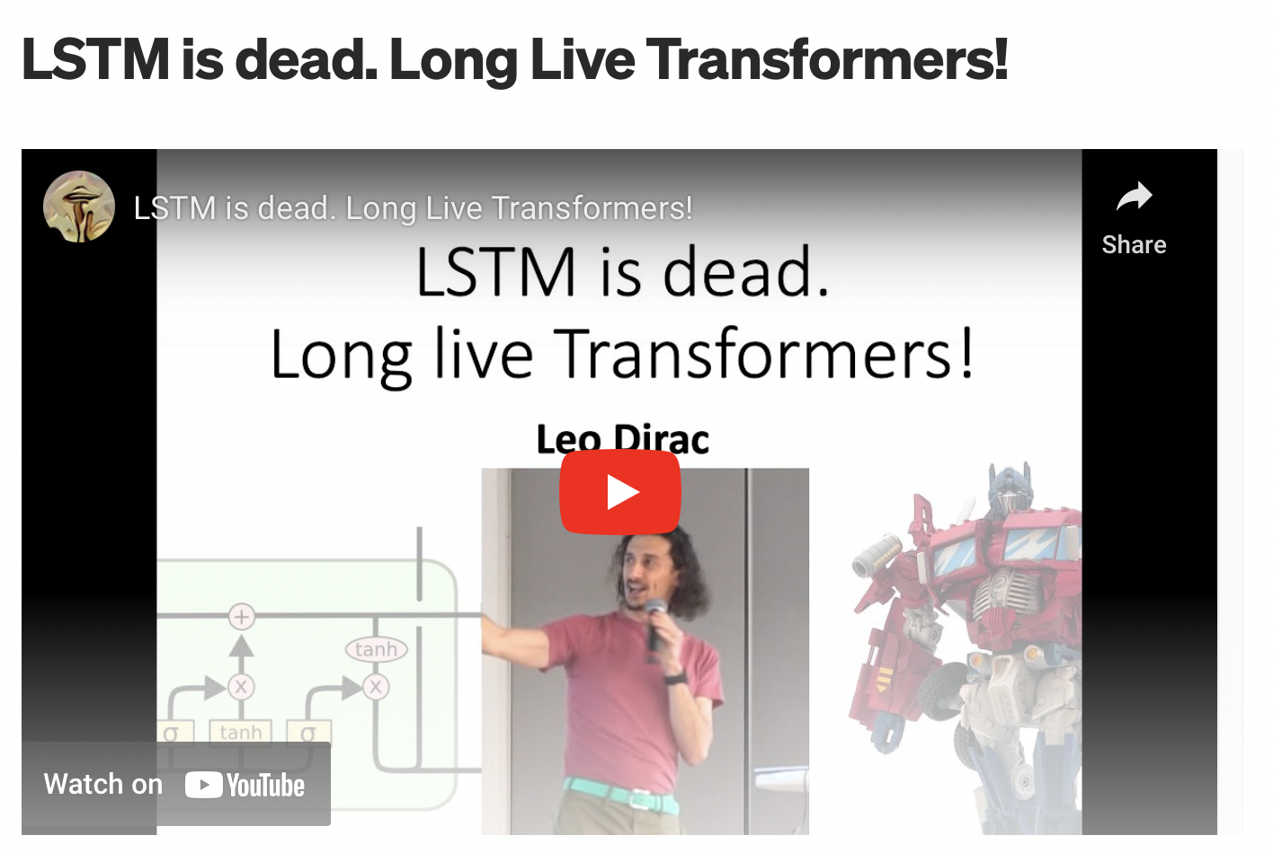
“The King is dead, long live the King!”
Sequential process are slow, transformers allow parallelization
Longer theoretical memory
Temporal Dynamics and Recurrent Neural Networks

Slide 6
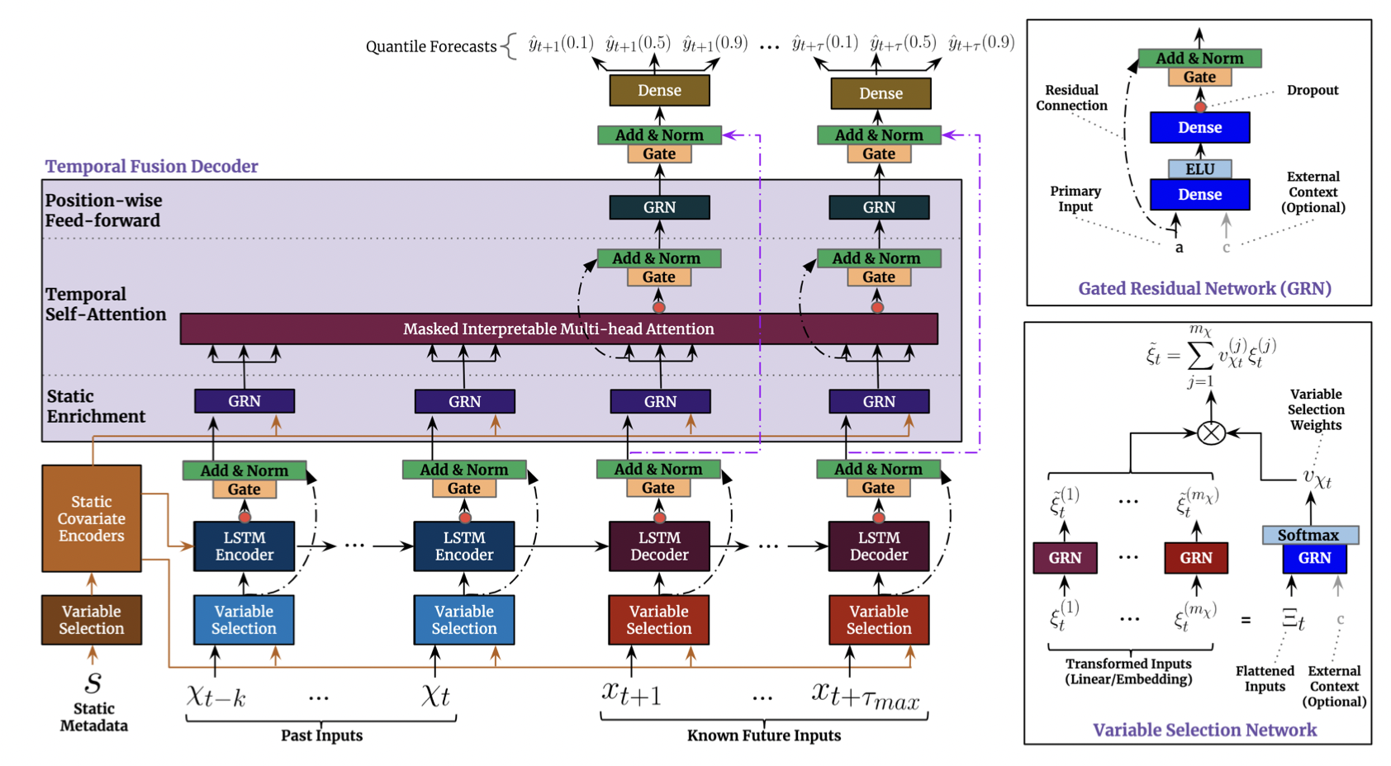
The report of my death was an exaggeration – Mark Twain
Time series
Modelling static data
Temporal fusion transformer (TFT)
Recurrent networks still included in SOTA forecasting algorithms
Bryan Lim, Sercan O. Arik, Nicolas Loeff, and Tomas Pfister, “Temporal fusion transformers for interpretable multi-horizon forecasting,” International Journal of Forecasting, Volume 37, 2021
Temporal Dynamics and Recurrent Neural Networks

Slide 7
Recurrent networks (RNN) tutorial
Generic RNN description
Long short-term memory (LSTM) networks and other RNN variants
(Code) LSTMs for Lorenz 96
(Code) LSTMs for sea-surface temperature estimation
Temporal Dynamics and Recurrent Neural Networks

Slide 8
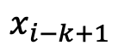
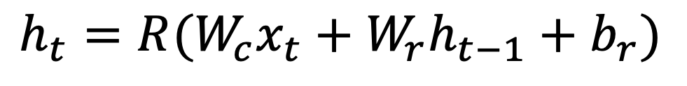
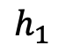
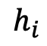
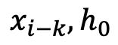
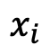
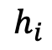
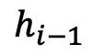
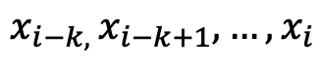

Generic RNN (sequence to vector)
$$h_{i}$$
$$h_{i}$$
$$h_{1}$$
$$…$$
$$h_{i−1}$$
RNN
RNN
RNN
RNN
$${x_{i−k, }x_{i−k+1}, …,x}_{i}$$
$$x_{i−k}, h_{0}$$
$$x_{i−k+1}$$
$$x_{i}$$
$$h_{t}=R(W_{c}x_{t}+W_{r}h_{t−1}+b_{r})$$
State estimation
Sentiment analysis
Forecasting
Temporal Dynamics and Recurrent Neural Networks

Slide 9
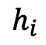
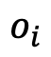
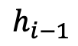
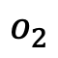
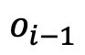

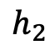
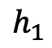
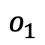
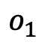
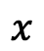
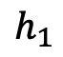
Generic RNN (vector to sequence)
$$o_{1}$$
$$o_{2}$$
$$o_{i}$$
Output Process
Output Process
Output Process
Decoder in machine translation
Image captioning
$$h_{1}$$
$$h_{2}$$
$$h_{i}$$
$$h_{1}$$
$$…$$
$$h_{i−1}$$
RNN
RNN
RNN
$$x$$
$$o_{1}$$
Embedding
$$o_{i−1}$$
Embedding
Temporal Dynamics and Recurrent Neural Networks

Slide 10
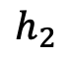
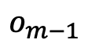
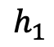
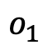
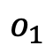
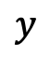
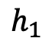
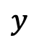
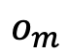
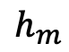
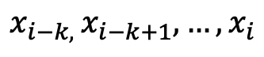
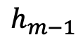
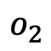
Generic RNN (sequence to sequence)
$$o_{1}$$
$$o_{2}$$
$$o_{m}$$
Machine translation
Movie captioning
Forecasting
Output Process
Output Process
Output Process
$$y$$
$$h_{1}$$
$$h_{2}$$
$$h_{m}$$
RNN Encoder
RNN Decoder
$$h_{1}$$
RNN Decoder
$$…$$
$$h_{m−1}$$
RNN Decoder
$${x_{i−k, }x_{i−k+1}, …,x}_{i}$$
$$y$$
$$o_{1}$$
Embedding
$$o_{m−1}$$
Embedding
Temporal Dynamics and Recurrent Neural Networks

Slide 11
RNN Forecasting (Code)
GitHub: https://github.com/dynamicslab/ctf-dl-tutorial
Temporal Dynamics and Recurrent Neural Networks

Slide 12
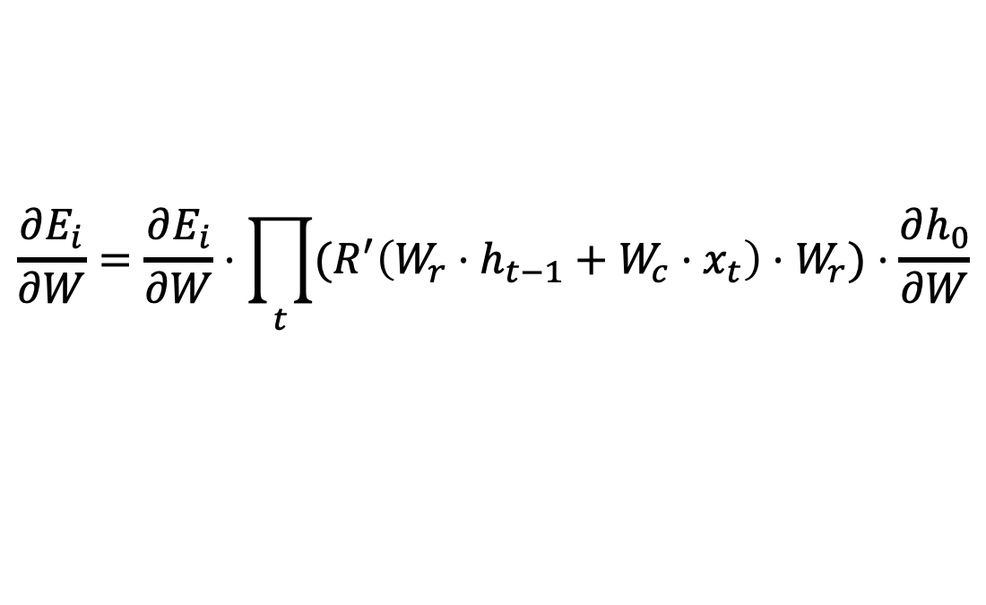
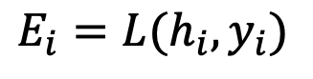
Vanishing gradients
Loss
$$E_{i}=L(h_{i},y_{i})$$
$$h_{i}$$
$$h_{i}$$
$$h_{1}$$
$$…$$
$$h_{i−1}$$
RNN
RNN
RNN
RNN
$${x_{i−k, }x_{i−k+1}, …,x}_{i}$$
$$x_{i−k}, h_{0}$$
$$x_{i−k+1}$$
$$x_{i}$$
Recurrence Relation
Gradient Calculation
$$h_{t}=R(W_{c}x_{t}+W_{r}h_{t−1})$$
$$\frac{∂E_{i}}{∂W}=\frac{∂E_{i}}{∂W}⋅\prod_{t}{{(R}^{′}\left(W_{r}⋅h_{t−1}+W_{c}{⋅x}_{t}\right)⋅W_{r})}⋅\frac{∂h_{0}}{∂W}$$
Temporal Dynamics and Recurrent Neural Networks

Slide 13
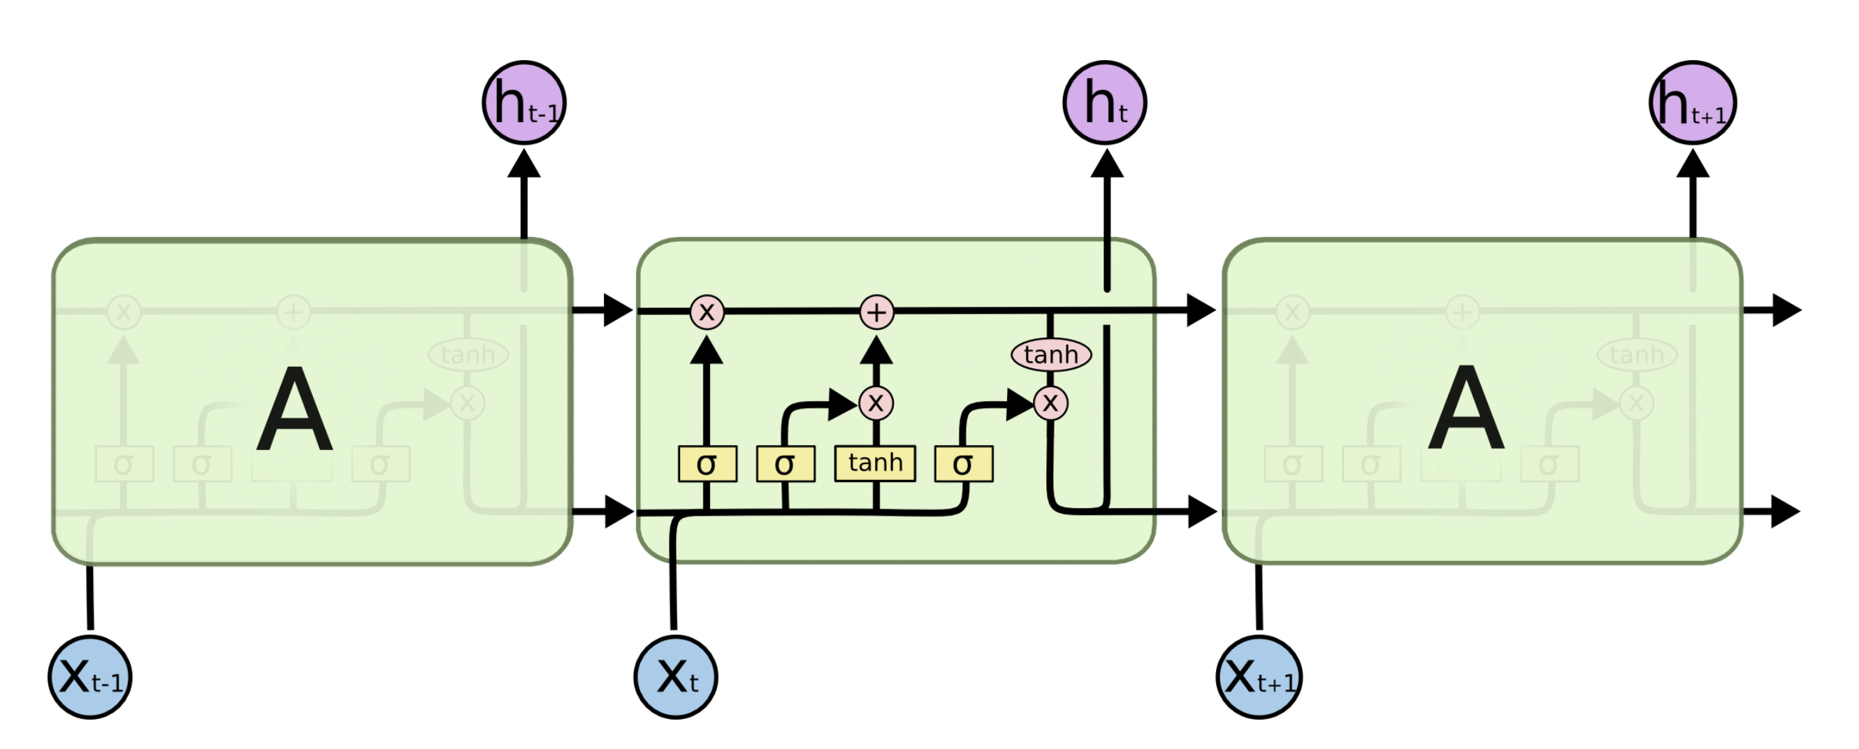
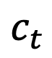
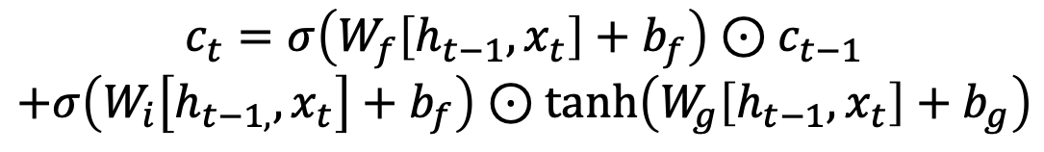
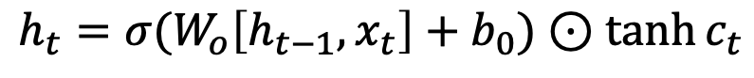
Long short-term memory networks
$$c_{t}$$
$$h_{t}=σ(W_{o}\left[h_{t−1},x_{t}\right]+b_{0})⊙\tanh{c_{t}}$$
$$c_{t}=σ\left(W_{f}\left[h_{t−1},x_{t}\right]+b_{f}\right)⊙c_{t−1}$$
$$+σ\left(W_{i}\left[h_{t−1,},x_{t}\right]+b_{f}\right)⊙\tanh\left(W_{g}\left[h_{t−1},x_{t}\right]+b_{g}\right)$$
Image from Christopher Olah’s blog, ”Colah’s blog”
Temporal Dynamics and Recurrent Neural Networks

Slide 14
Lorenz 96 (Code)
GitHub: https://github.com/dynamicslab/ctf-dl-tutorial
Temporal Dynamics and Recurrent Neural Networks

Slide 15
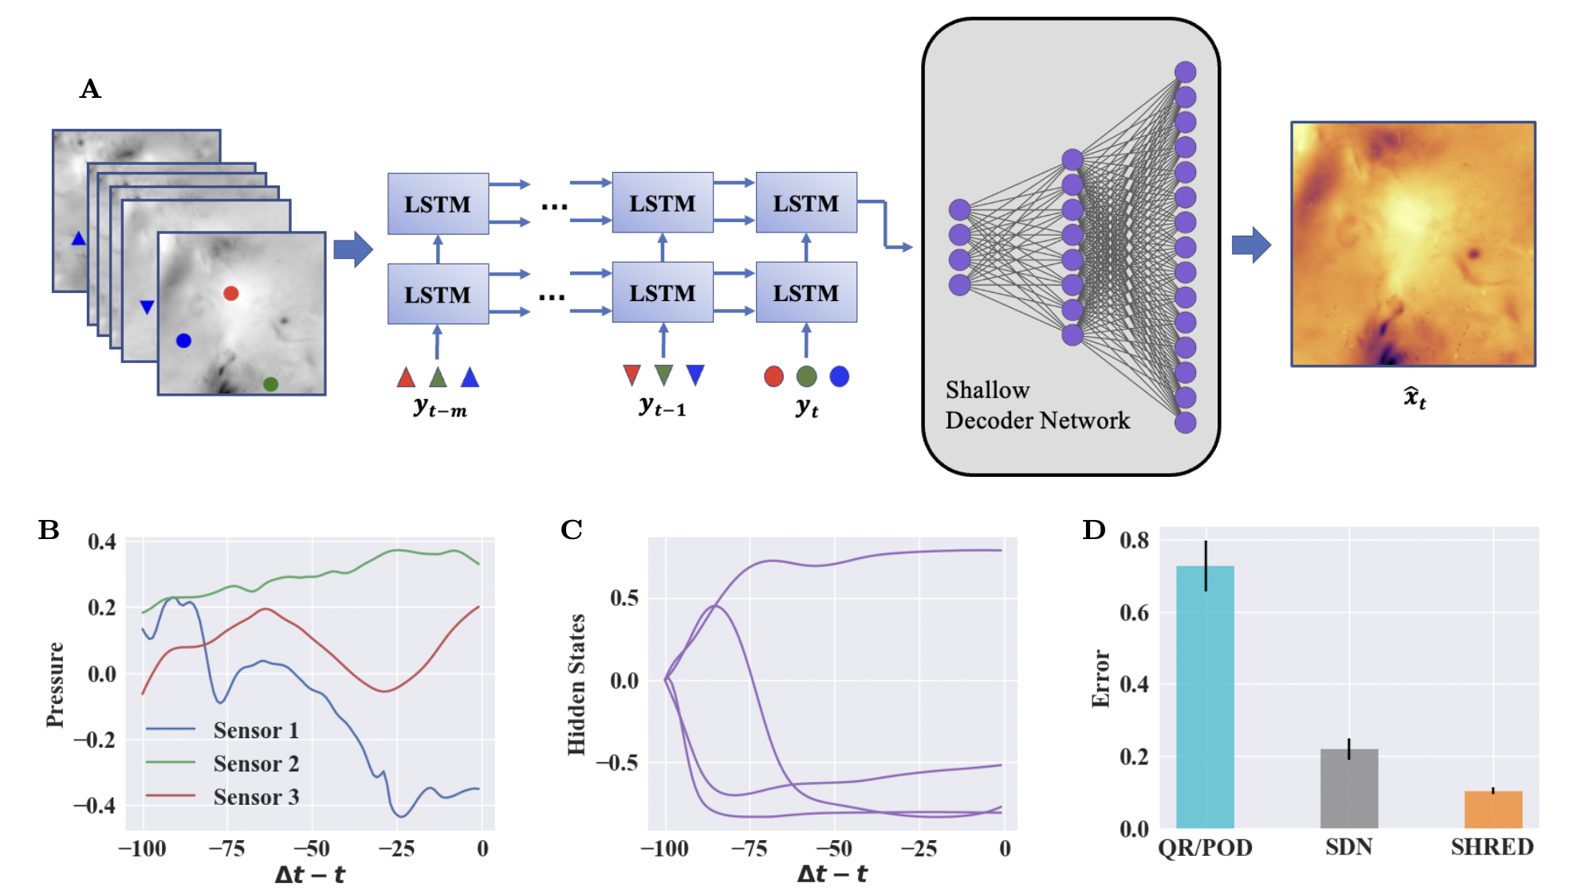
SHallow REcurrent Decoder (SHRED) reconstructions
$$H\left({\left\{y_{i}\right\}}_{i=1}^{T};W_{RN}, W_{SD}\right)=F\left(G\left({\left\{y_{i}\right\}}_{i=1}^{T};W_{RN}\right);W_{SD}\right)$$
Temporal Dynamics and Recurrent Neural Networks

Slide 16
SHallow REcurrent Decoder Networks (Code)
GitHub: https://github.com/dynamicslab/ctf-dl-tutorial
Temporal Dynamics and Recurrent Neural Networks

Slide 17
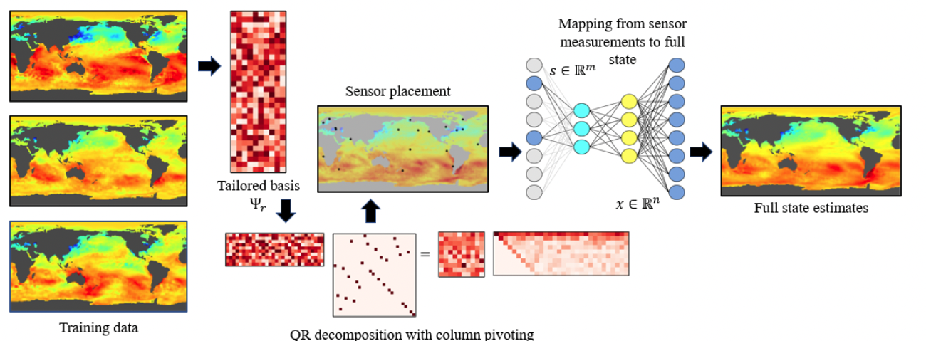
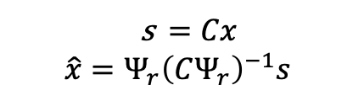
Linear reconstructions (QR/POD)
s $=Cx$
$$\hat{x}=Ψ_{r}{\left(CΨ_{r}\right)}^{−1}s$$
[1] K. Manohar et al., “Data-driven sparse sensor placement for reconstruction,” IEEE control systems, vol. 38, pp. 63–, 05 2018.
Sensing with Shallow Recurrent Decoders

Slide 18
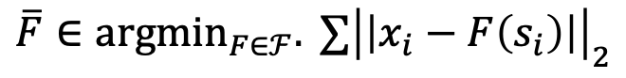

Shallow Decoder Network (SDN) Reconstructions
$$F\left(s;W_{SD}\right)=R\left(W^{k}R\left(W^{k−1}⋯R\left(W^{1}s\right)\right)\right)$$
$$\overline{F}∈{argmin}_{F∈ℱ}. ∑{\left|\left|x_{i}−F\left(s_{i}\right)\right|\right|}_{2}$$
[1] N. B. Erichson et al., “Shallow neural networks for fluid flow reconstruction with limited sensors,” Proc. R. Soc. A, vol. 476, May 2020.
[2] J. Williams, O. Zahn, and J. N. Kutz, “Data-driven sensor placement with shallow decoder networks,” arXiv preprint arXiv:2202.05330v1, 2022.
Sensing with Shallow Recurrent Decoders

Slide 19
Limitations of existing techniques
QR Sensors, POD Reconstruction
Requires principled sensor placement
Relies only on static measurements
Shallow decoder networks
Improved reconstructions from principled sensors
Relies only on static measurements
Goal: Incorporate sensor trajectories in methods for reconstruction
Sensing with Shallow Recurrent Decoders

Slide 20


Long short-term memory networks
Recurrent neural networks (RNN)
Receives sequence of inputs, generates sequence of outputs
Suffers from issue of vanishing gradients
Long short-term memory networks (LSTM)
Class of RNN that introduces “gradient super-highway”
Widely used in low-dimensional time-series forecasting
$$h_{t}=G({\left\{x_{t}\right\}}_{i=1}^{T};W_{RN})$$
[1] X. H. Le et al., “Application of long short-term memory (LSTM) neural network for flood forecasting,” Water 11, no. 7, 2019.
Sensing with Shallow Recurrent Decoders

Slide 21
Performance comparison
Johns Hopkins, forced isotropic turbulent flow
1,667 snapshots of 350 by 350 grid
Shaded regions denote 10th and 90th percentiles
[1] Y. Li et al., “A public turbulence database cluster and applications to study of Lagrangian evolution of velocity increments in turbulence,” Journal of Turbulence, vol. 9, Jan 2008.
Sensing with Shallow Recurrent Decoders

Slide 22

Performance comparison
NOAA, weekly mean sea-surface temperature
1,400 snapshots of 180 by 360 grid
Images show difference from mean temperature
[1] R. W. Reynolds et al.., “An improved in situ and satellite SST analysis for climate,” Journal of Climate, vol. 15, July 2002.
Sensing with Shallow Recurrent Decoders

Slide 23

Performance comparison
Concentration of atmospheric ozone, GEOS-Chem
2,600 snapshots of 46 by 72 by 30 grid (latitude, longitude, elevation)
Lowest elevation snapshots shown
Data compressed via rank 50 SVD approximation
[1] I. Bey et al.., “Global modeling of tropospheric chemistry with assimilated meteorology: Model description and evaluation,” Journal of Geophysical Research, vol. 106, 2001.
Sensing with Shallow Recurrent Decoders

Slide 24




Forecasting Results
Turbulent Flow
Atmospheric Ozone
LSTM trained to forecast sensor measurements
Reconstructions obtained through forecasted sensor results
Sensing with Shallow Recurrent Decoders

Slide 25


Forecasting Results (SST)
Sea Surface
Sensing with Shallow Recurrent Decoders

Slide 26
Summary and future work
SHRED incorporates sensor trajectories to improve high-dimensional state estimates
SDNs and SHRED for seismic monitoring
Data compression
Reduced order modelling
Sensing with Shallow Recurrent Decoders

